Slide 1
Writing Papers in the Biological Sciences
An introduction to Biological research and paper writing

Slide 2
Chapter Four: Writing a Research Paper and Lab Report
Order of the Research Paper
  Abstract
  Introduction
  Materials and Methods
  Results
  Discussion
  Acknowledgements
  Literature cited/references
*You don’t have to write these sections in this order, start with what you find easiest and work from there.

Slide 3
Title:
  Make the title informative and specific
  Use key words to attract a reader
  Be concise - get rid of “fluff”
  Include appropriate taxonomic information.
  Be specific if writing about a particular organism
  Use terms familiar to the audience
  Don’t use abbreviations - except if they are widely used (DNA, RNA, ATP, etc)

Slide 4
Abstract:
  Keep to about 250-300 words
  Summarize the major points of the paper: - - objectives
  - methods
  - results
  - conclusion
  Usually written last.
  Be specific and concise
  Should be able to stand alone

Slide 5

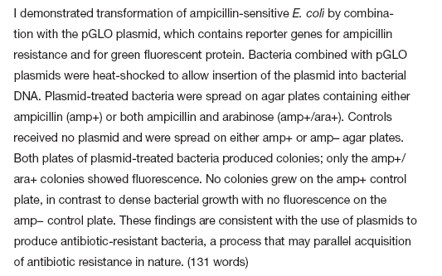



Slide 6
Abstract !!
Common Mistakes
  Too much background or methods information
  Figures or images
  References to other literature, figures or images
  Abbreviations or acronyms

Slide 7
Introduction:
  Should hook your reader
  Orient the reader by summarizing pertinent literature in your field
  Include your rationale for your research
  One of the last sections written
  Start with broad research and work down to more specific research
  End with what your research is and a version of your hypothesis (work objectives).

Slide 8
Introduction !!
Common Mistakes
  Too much or not enough information
  Unclear purpose
  Lists
  Confusing structure
  First-Person narratives

Slide 9
Materials and Methods:
  Materials: what you will work on such as organism
  Methods: Describe the procedures in detail.
  Include enough information so that your study could be repeated.
  Be organized - outline it first
  Usually written first!
  Be specific and informative
  Omit unnecessary information
  ****Use a passive voice and stay away from using 1st or 2nd person (no I, me, my, we, our, their, etc)
  DO NOT INCLUDE RESULTS!

Slide 10
Methods and Materials
Provides instruction on exactly how to repeat experiment
  Subjects
  Sample preparation techniques
  Sample origins
  Field site description
  Data collection protocol
  Data analysis techniques
  Any computer programs used
  Description of equipment and its use

Slide 11
Methods and Materials !!
Common Mistakes
  Too little information
  Information from Introduction
  Verbosity
  Results/ sources of error reported

Slide 12
Results:
  Summarize the data with an emphasis on important patterns or trends
  Illustrate and support by using details, statistics, examples, tables and figures
  DO NOT MAKE CONCLUSIONS! Or interpret the data…Just report the data
  Integrate quantitative data with your text
  Be specific.
  Omit peripheral information and unnecessary details.

Slide 13
Figures and Tables
Tables
  Presents lists of numbers/ text in columns
Figures
  Visual representation of results or illustration of concepts/methods (graphs, images, diagrams, etc.)
Captions
  Must be stand-alone

Slide 14
Figures and Tables
Guidelines for Figures and Tables
  High resolution
  Neat, legible labels
  Simple
  Clearly formatted
  Indicate error
  Detailed captions

Slide 15
Results !!
Common mistakes
  Raw data
  Redundancy
  Discussion and interpretation of data
  No figures or tables
  Methods/materials reported

Slide 16
Discussion
  Interpretation of your results
  Use evidence to support your conclusions
  What do your results really mean?
  Don’t give every explanation - give the best.
  Don’t forget the lack of a relationship is as important as a definite relationship
  Be confident in your ideas
  Opposite to the introduction - start specific and work to more general
  Use a coherent, logical organization.

Slide 17
Discussion
Interpret results
  Did the study confirm/deny the hypothesis?
  If not, did the results provide an alternative hypothesis? What interpretation can be made?
  Do results agree with other research? Sources of error/anomalous data?
  Implications of study for field
  Suggestions for improvement and future research?
Relate to previous research

Slide 18
Discussion !!
Common Mistakes
  Combined with Results
  New results discussed
  Broad statements
  Incorrectly discussing inconclusive results
  Ambiguous data sources
  Missing information

Slide 19
Acknowledgment :
In this section you list sources of funding for the project and thank anyone who assisted you with your research or with the preparation of your paper.
References / Literature cited:
List all the references cited (referred to) in your paper.

Slide 20
References
Check specific referencing style of journal
Should reference:
  Peer-reviewed journal articles, abstracts, books
Should not reference:
  Non-peer-reviewed works, textbooks, personal communications

Slide 21
References !!
Common Mistakes
  Format, Format, Format
    (Figures & Tables, Equations, and References)
  Redundant Information
    Text, Figures, Tables, and Captions
  Type of Reference

